Slide 1

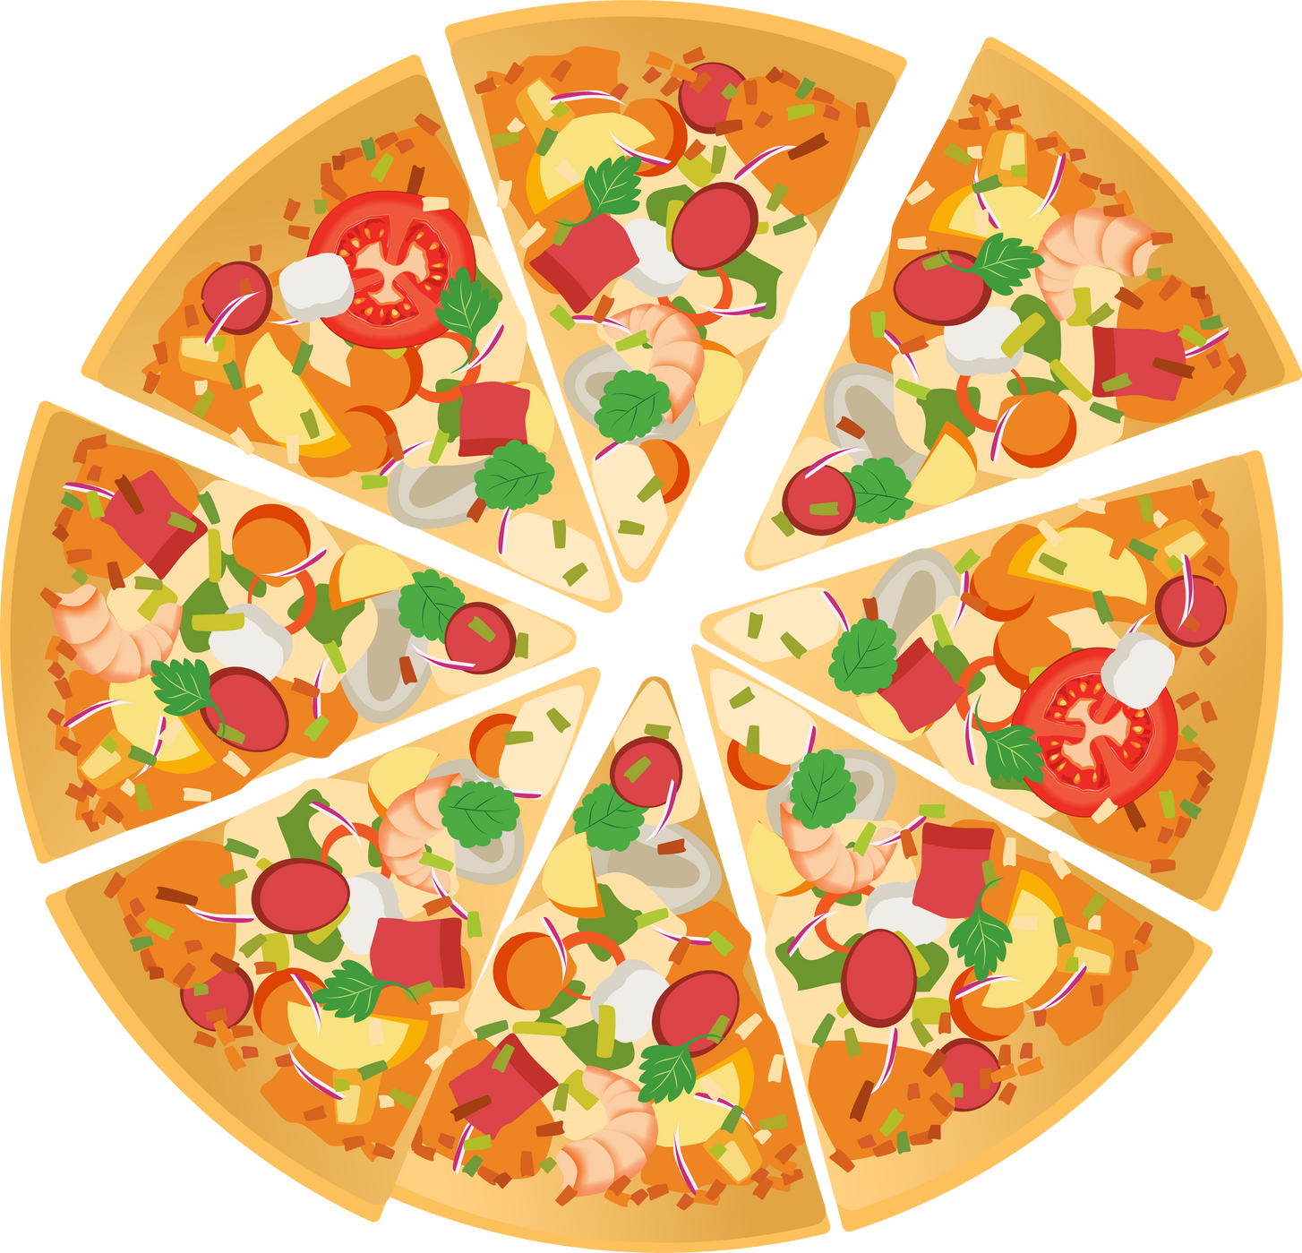
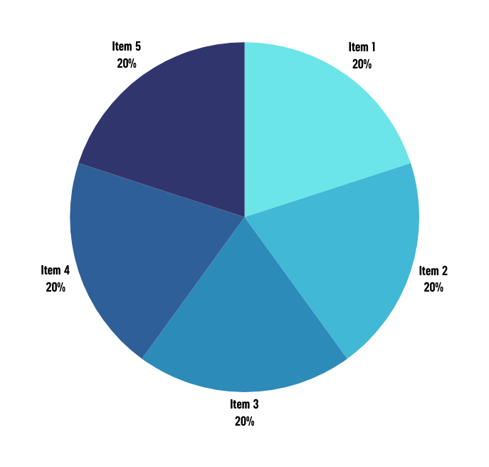
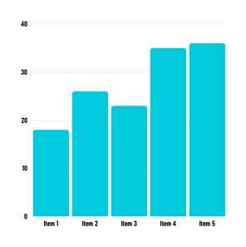
Pizza Sales Analysis
using SQL
by Sukender Reddy Mamidala

Slide 2


Introduction
Pizza Sales Analysis 🍕📊
Presented by: Sukender Reddy
This project analyzes pizza sales data using SQL and visualization techniques to uncover insights on revenue trends, top-selling pizzas, and customer preferences. By identifying sales patterns, businesses can optimize inventory, pricing, and customer satisfaction.
🚀 Let’s explore the data and discover what drives pizza sales success! 🍕

Slide 3
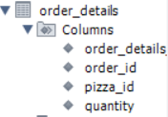

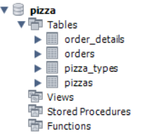
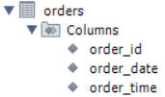
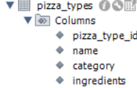
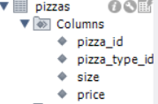
Data Overview

Slide 4
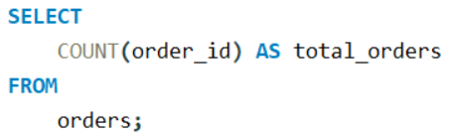
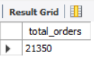
Retrieve total number of orders placed.

Slide 5
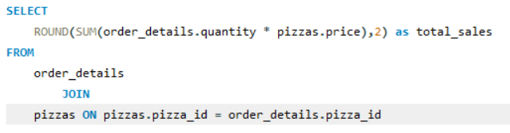
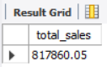
Calculate the total revenue generated from pizza sales.

Slide 6
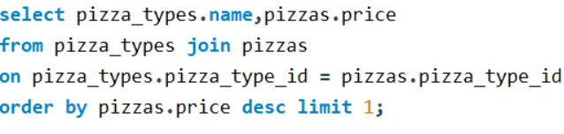
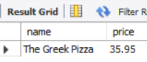
Identify the highest-priced pizza

Slide 7
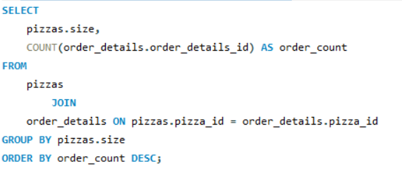
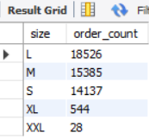
Identify the most common pizza size ordered.

Slide 8
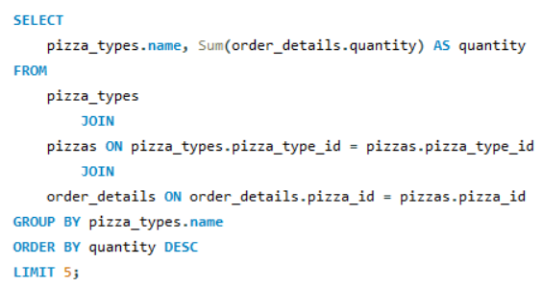
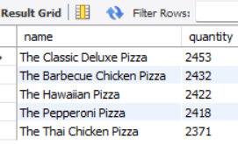
List the top 5 most ordered pizza types along with their quantities.

Slide 9
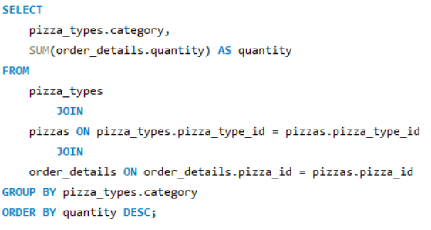
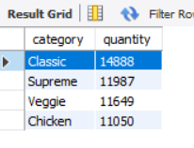
Join the necessary tables to find the total quantity of each pizza category ordered.

Slide 10
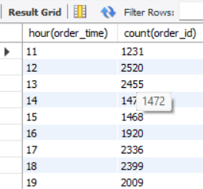
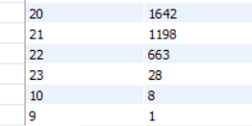
Determine the distribution of orders by hour of the day.

Slide 11
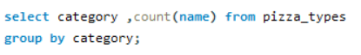
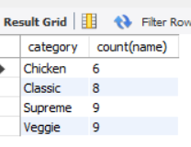
Find the category-wise distribution of pizzas.

Slide 12
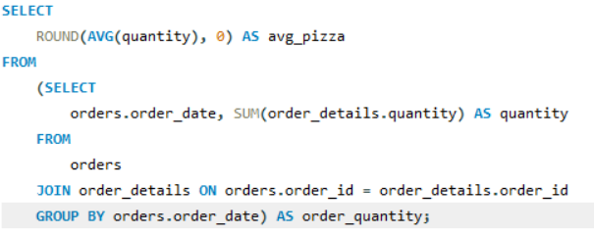
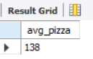
Group the orders by date and calculate the average number of pizzas ordered per day.

Slide 13
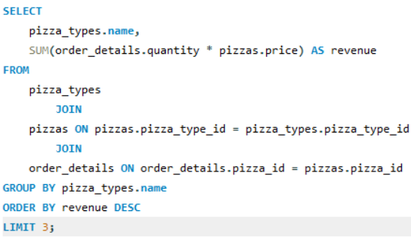
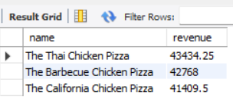
Determine the top 3 most ordered pizza types based on revenue.

Slide 14
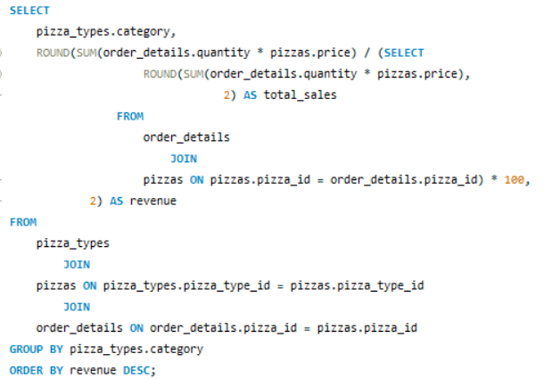
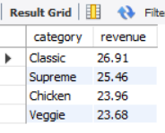
Calculate the percentage contribution of each pizza type to total revenue.

Slide 15
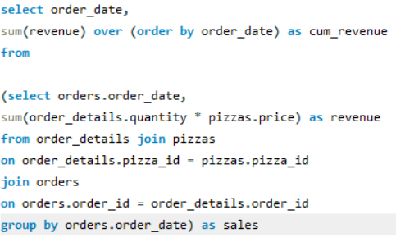
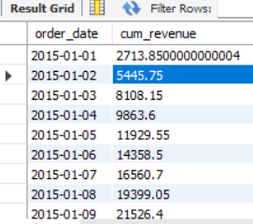
Analyze the cumulative revenue generated over time.

Slide 16
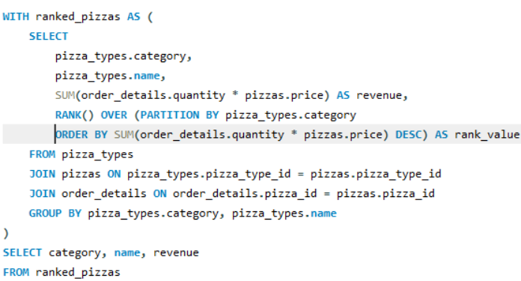
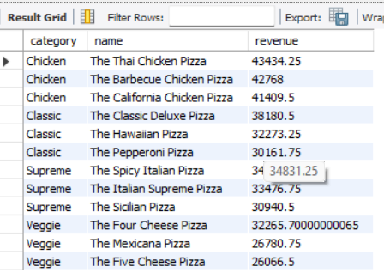
Determine the top 3 most ordered pizza types based on revenue for each pizza category.

Slide 17


Thank You

